Slide 1
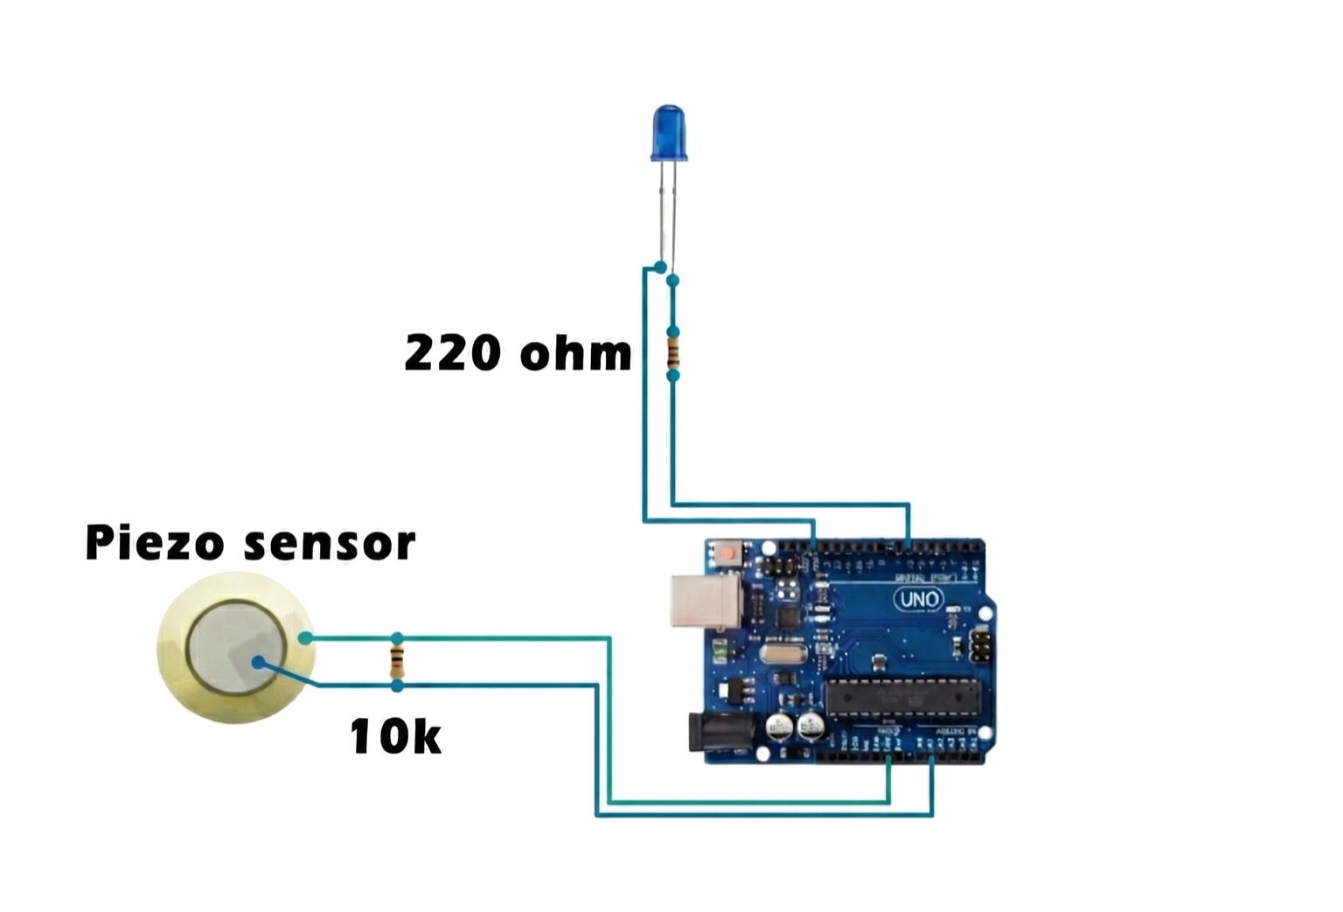
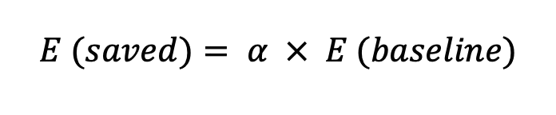
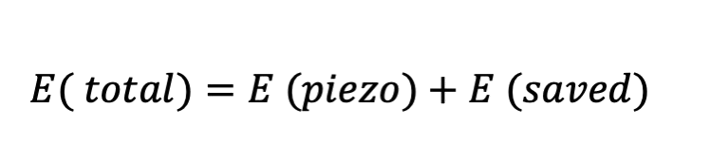
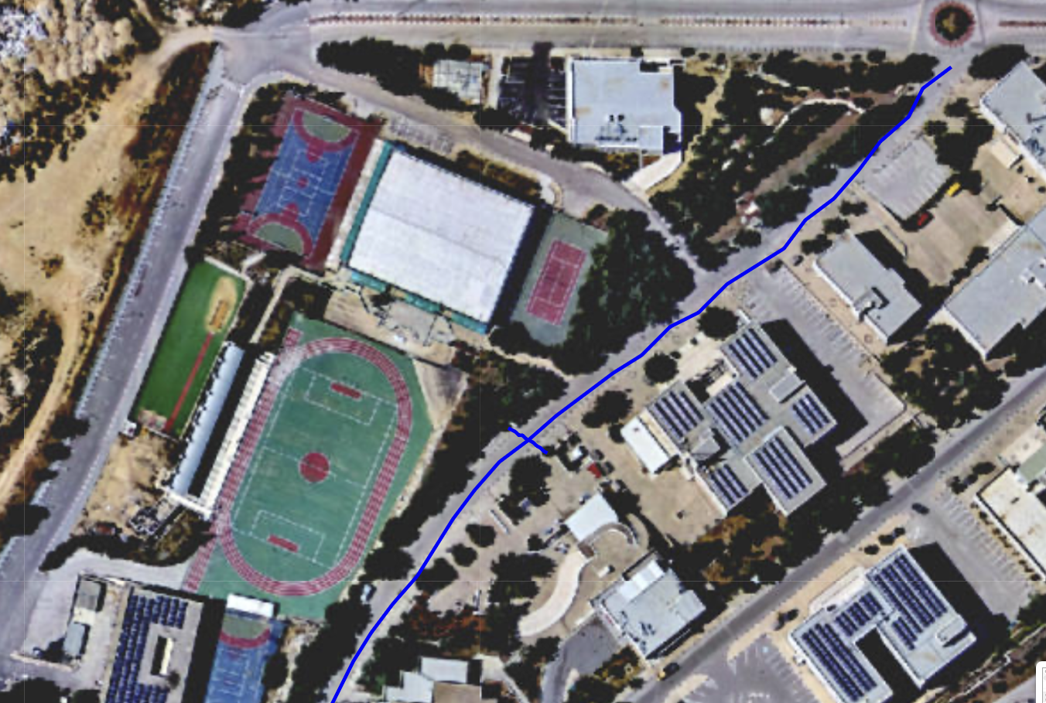

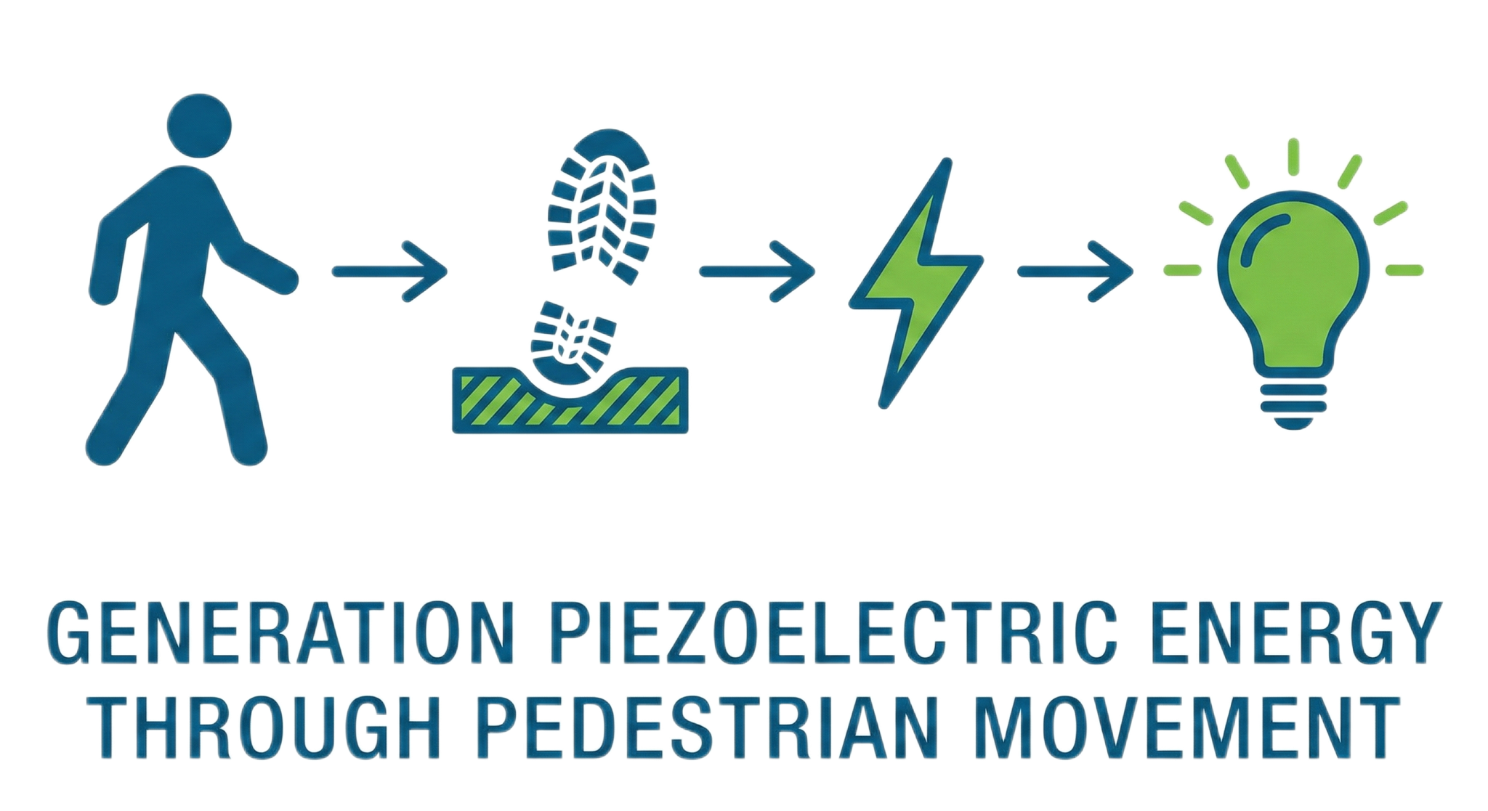
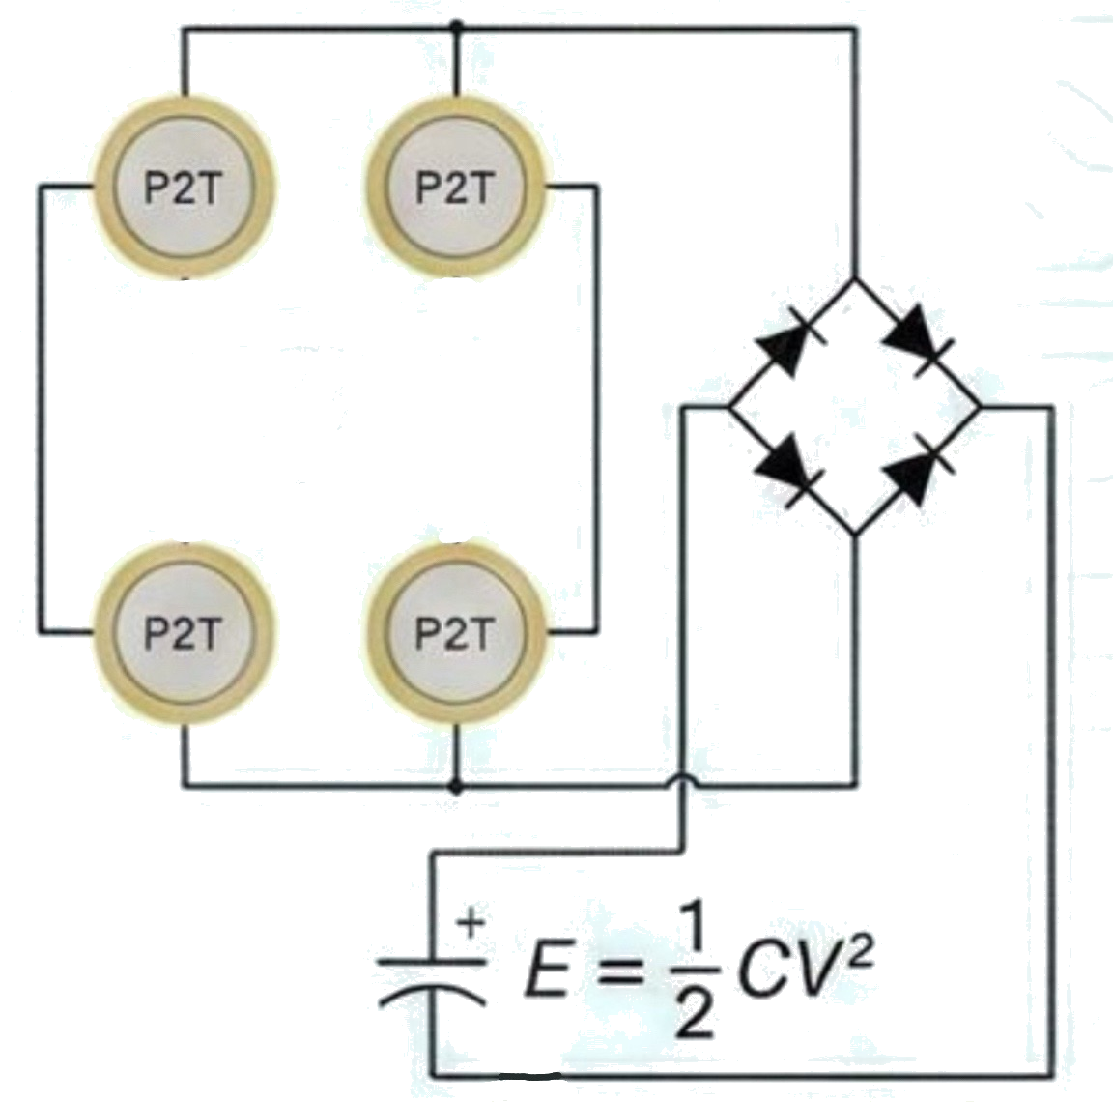

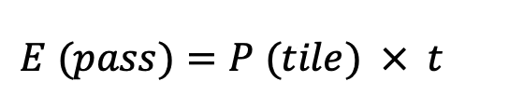

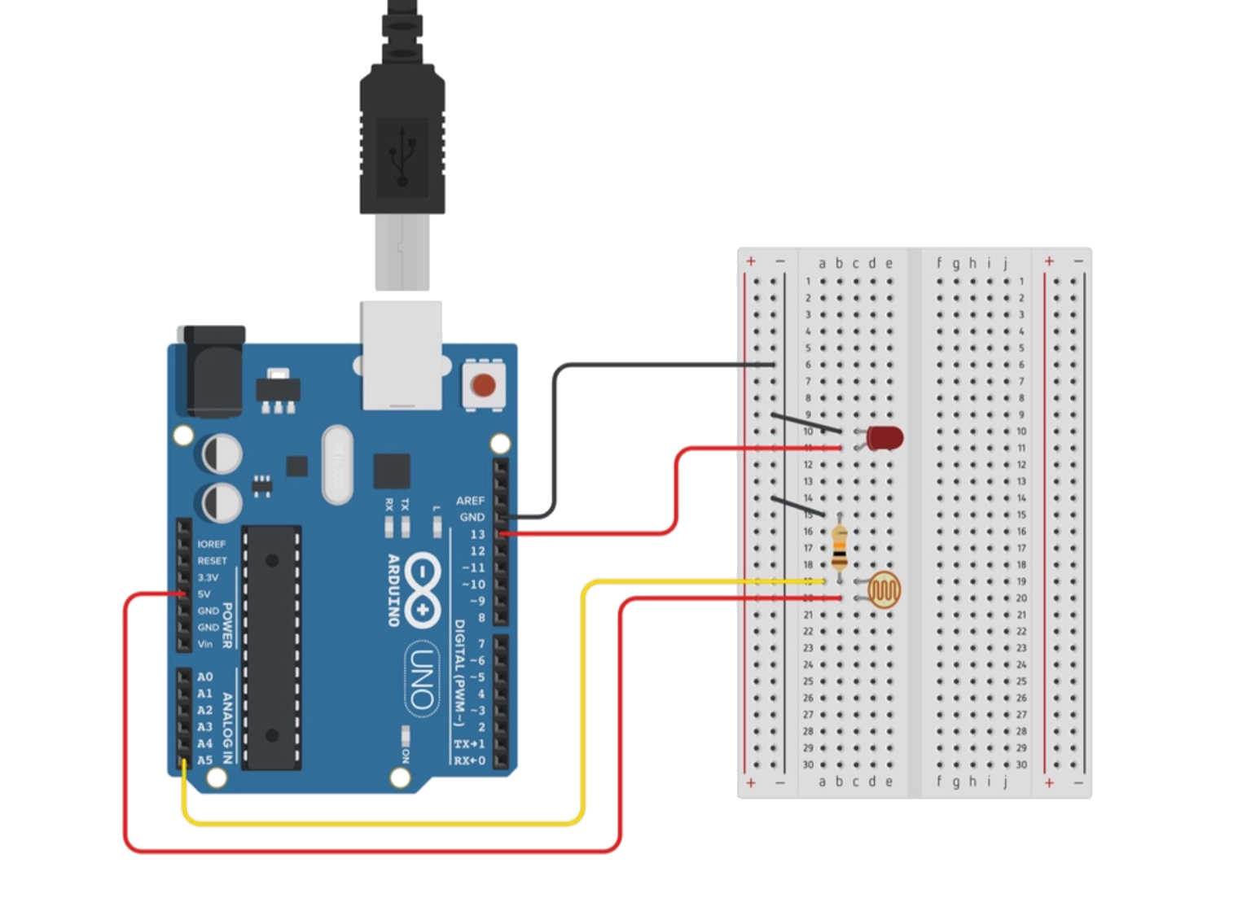
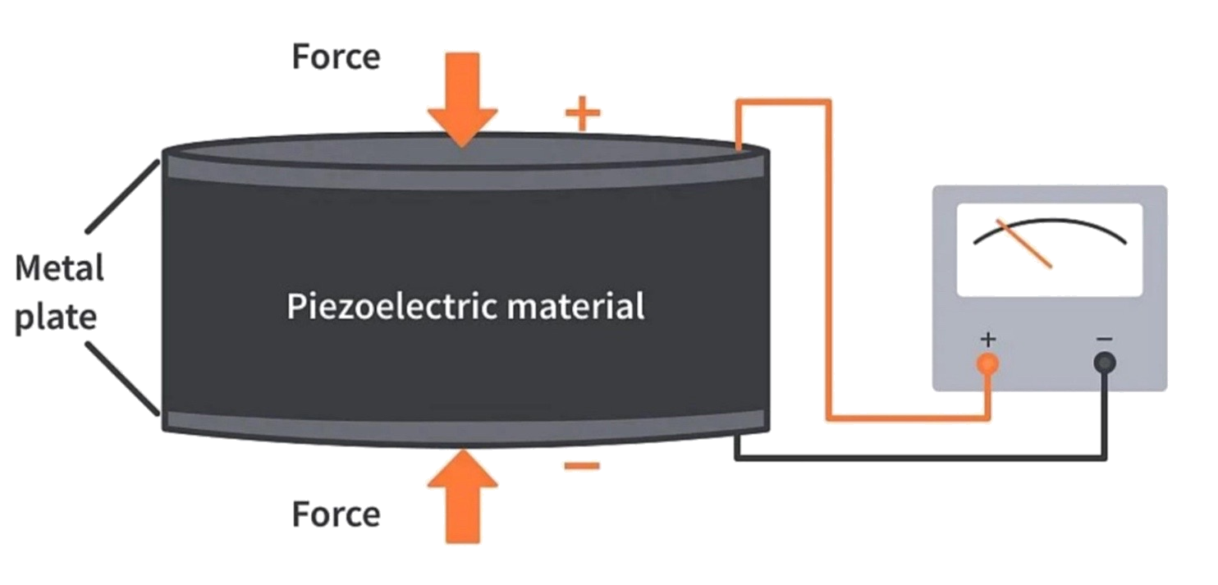
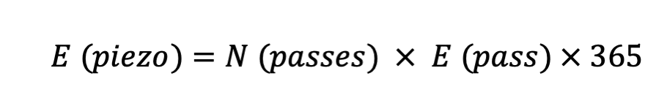
Piezoelectric Energy Harvesting In Pedestrian Walkaways
Design, prototyping, and feasibility Assessment for smart lighting
Alma Alkhader, Hala Kharouf
Birzeit university
Introduction and motivation
Technical implementation and proof of concept
Economic and energy feasibility analysis
Palestine’s electricity sector continues to face structural difficulties due to its heavy reliance on imported electricity and the limited contribution of locally produced renewable energy. According to the Palestinian Energy and Natural Resources Authority, over 85% of Palestine’s electricity is imported, with renewable energy representing only a very small portion of the overall electricity supply. This reliance places public institutions under financial strain, especially universities that depend on continuous lighting. University campuses have pedestrian corridors with heavy daily foot traffic; however, the mechanical energy produced by human movement is largely wasted. While Palestine has seen increased reliance on solar energy projects, there is still a lack of research focused on small-scale and site-specific energy harvesting solutions appropriate for institutional use. In addition, academic buildings’ lighting systems frequently run inefficiently, operating at full capacity even when areas are empty or adequately lit by natural light.
This research examines the feasibility of implementing piezoelectric energy harvesting as an additional energy source for energy-efficient lighting at Birzeit University. It also assesses the potential contribution of harvested energy to corridor lighting in university buildings using motion- and light-aware control strategies. Experimental prototype validation is combined with field measurements from a high-pedestrian-density street near the Faculty of Arts. The goal is to determine whether, given practical operational limitations, such a system can effectively support smart lighting applications.
A laboratory-scale setup using four piezoelectric discs was used to verify voltage generation under mechanical loading. Applied pressure produced alternating voltage spikes that were directly monitored using an Arduino and LED, confirming piezoelectric energy generation but demonstrating the instability of unconditioned output.
The economic feasibility analysis was designed to quantify both the energy generated by piezoelectric flooring and the energy saved through sensor-based lighting control, and to evaluate their combined economic impact using a Levelized Cost of Energy (LCOE) framework
Site Selection
A high-pedestrian-density street at Birzeit University (Faculty of Arts street) was selected as the deployment site due to its continuous daily foot traffic.
Technology Selection
Sustainable Energy Floor (SEF) piezoelectric tiles were chosen based on their suitability for continuous walkways, mechanical robustness, defined power output, known lifespan, and compatibility with Levelized Cost of Energy (LCOE) analysis.
Tile Coverage and Capital Cost
The street dimensions were measured to determine the total usable area. The required number of SEF tiles was calculated as:
Using the manufacturer tile cost, the total capital cost of the flooring system was estimated.
Energy Generation Estimation
Based on SEF specifications, the electrical energy generated per pedestrian passage was calculated using the nominal tile power output and the time required to walk along the street:
Daily and annual harvested energy were then obtained using observed pedestrian flow:
.
Energy Savings from Sensor-Based Lighting
In parallel, energy savings from ambient-light-aware lighting control were evaluated. Baseline annual lighting consumption was calculated assuming continuous operation, and a conservative reduction factor was applied:
Total Energy Benefit and LCOE
The total annual energy contribution combines generated and saved energy:
Economic feasibility was assessed using the Levelized Cost of Energy:
Results and discussion
To stabilize the piezoelectric output, a full-wave bridge rectifier and a capacitor were integrated to convert the alternating voltage into a usable DC signal and enable temporary energy storage. An Arduino-based system monitored the stored voltage, demonstrating progressive energy accumulation and controlled activation of an LED under suitable conditions.
Technical Results
The prototype successfully demonstrated the full operational chain of the system. Mechanical loading of four piezoelectric elements generated alternating voltage spikes, confirming effective energy conversion. Direct connection to a load produced unstable output, highlighting the need for conditioning. After rectification and capacitive storage, repeated loading resulted in progressive voltage accumulation, confirming short-term energy storage. Integration of LDR-based sensing and transistor switching enabled conditional LED activation, validating controlled and demand-based energy usage.
Economic and Feasibility Results
Scaling the system to the Faculty of Arts street at Birzeit University using Sustainable Energy Floor (SEF) tiles resulted in an estimated 1281 kWh/year of harvested energy. In parallel, sensor-based lighting control reduced electricity consumption by approximately 886.95 kWh/year. The combined annual energy benefit was therefore 2167.95 kWh/year.
Using a 15-year lifetime, including capital, installation, and maintenance costs, the system yielded an LCOE of approximately 390 ILS/kWh. Annual monetary savings were estimated at ≈1193 ILS/year. While the LCOE exceeds grid electricity, the results indicate that the system is economically meaningful as a localized, supplementary solution, especially when energy harvesting is combined with guaranteed demand-side energy savings.
Theoretical background
Piezoelectric energy harvesting is based on the piezoelectric effect, where certain materials generate an electrical signal when mechanical stress is applied. When pedestrians walk over a piezoelectric element, the applied force causes mechanical deformation and electrical charge generation.
The direct piezoelectric effect is described by:
D=d .σ
where D is electric displacement, d is the piezoelectric coefficient, and σ is mechanical stress.
An LDR-based control logic was implemented to activate lighting only under low ambient light and sufficient stored energy conditions, demonstrating intelligent and energy-efficient load management.
Conclusion
This study demonstrates that piezoelectric energy harvesting can technically support smart lighting operation when combined with proper conditioning and sensor-based control. While the harvested energy alone is limited, integrating it with demand-side energy savings provides a feasible, localized contribution to campus energy efficiency.

